Slide 1
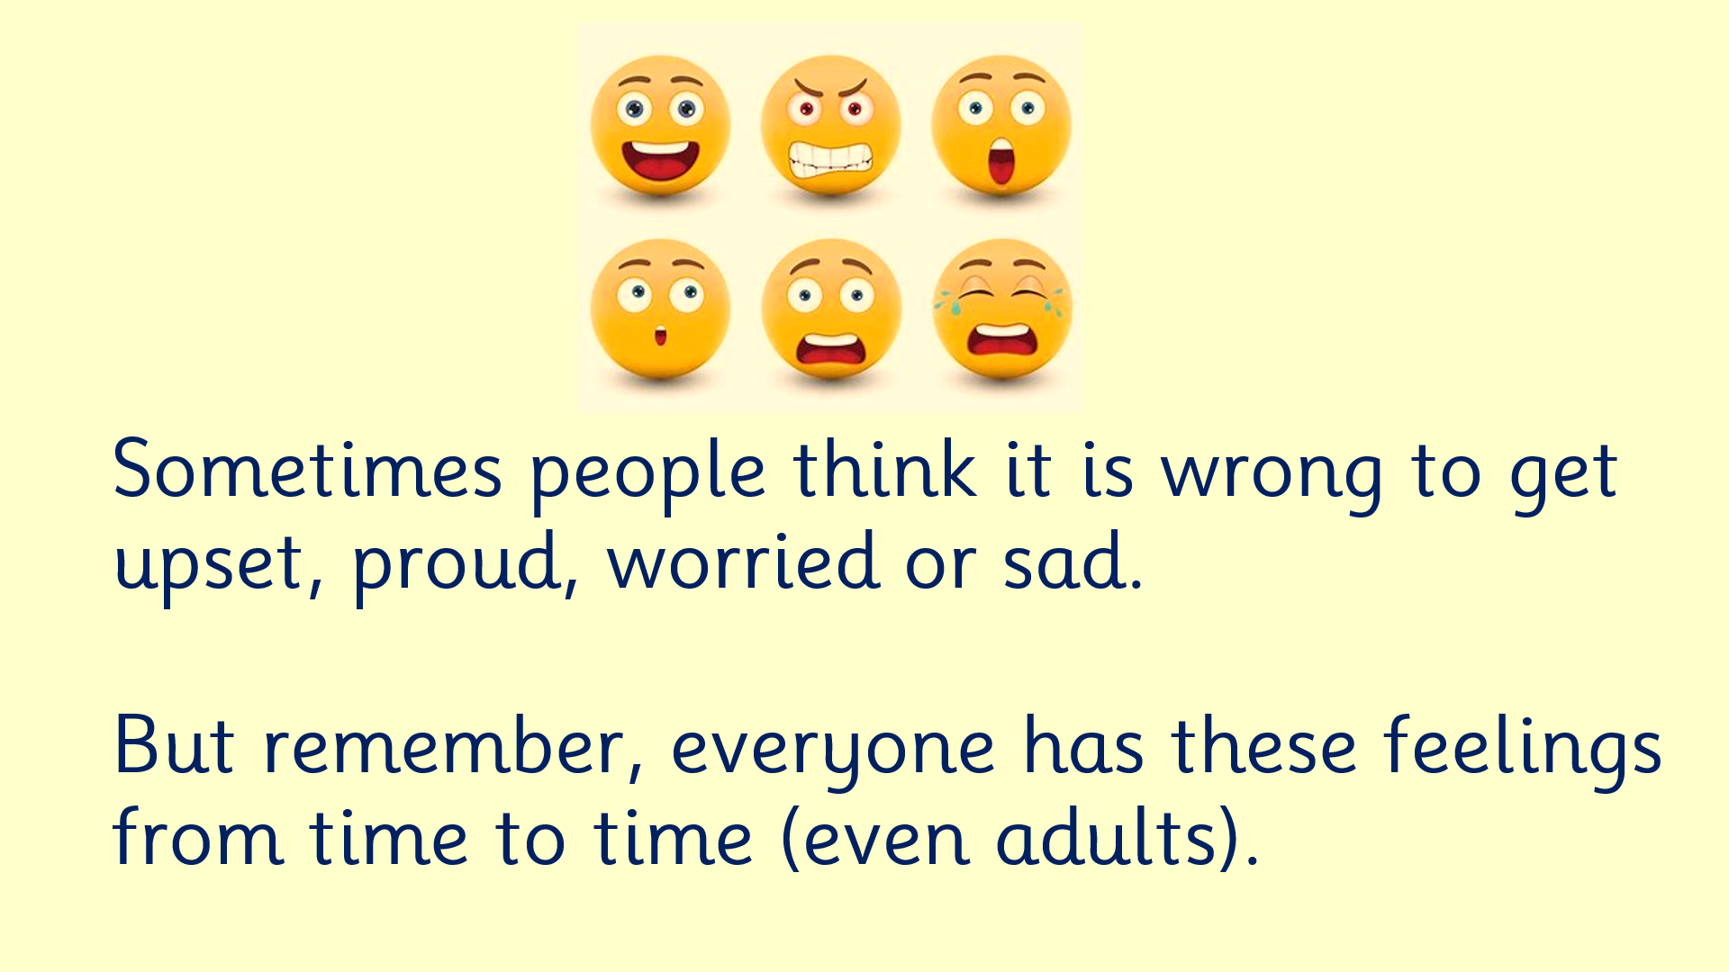
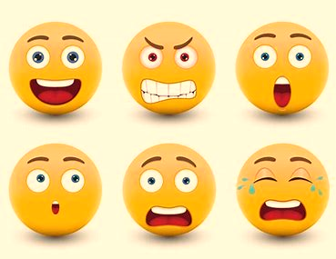
Sometimes people think it is wrong to get upset, proud, worried or sad.
But remember, everyone has these feelings from time to time (even adults).

Slide 2
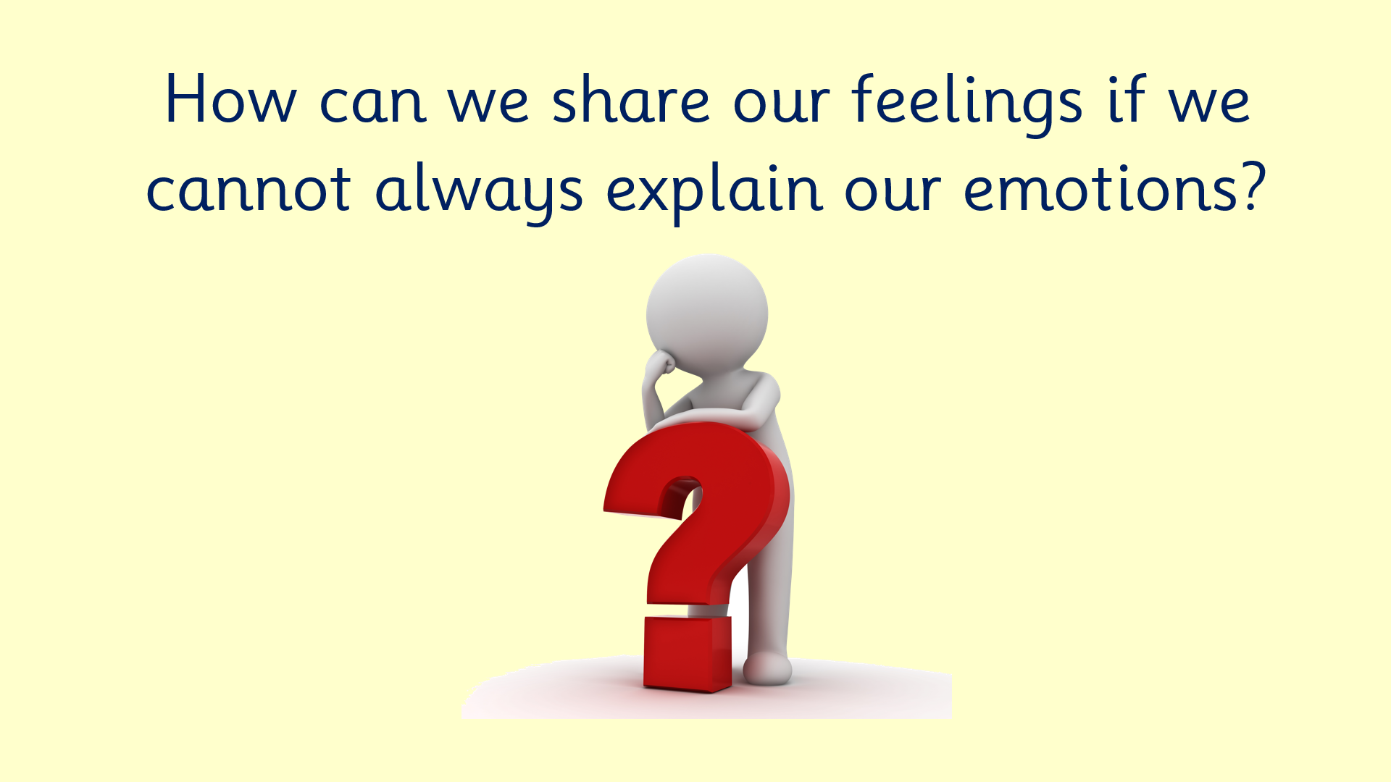

How can we share our feelings if we cannot always explain our emotions?

Slide 3
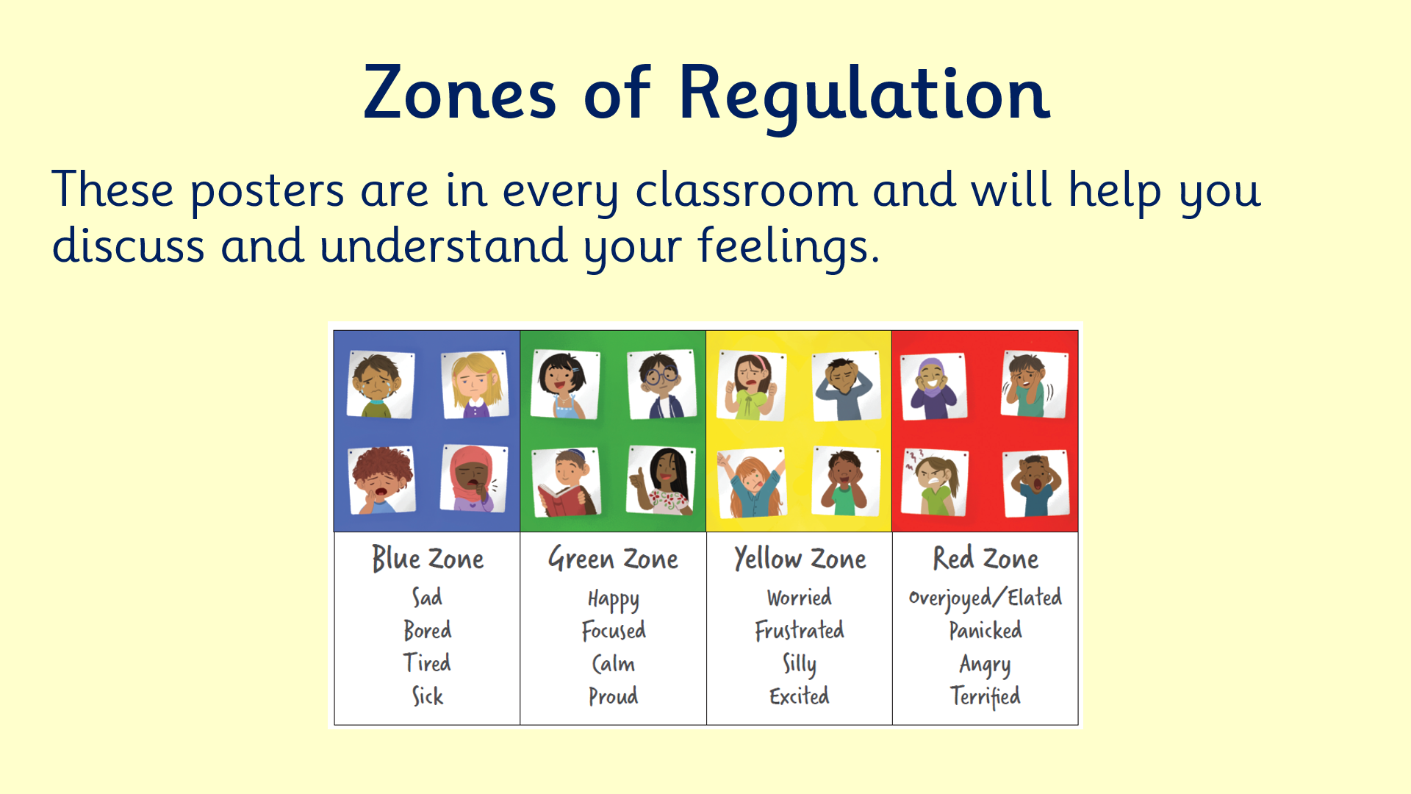
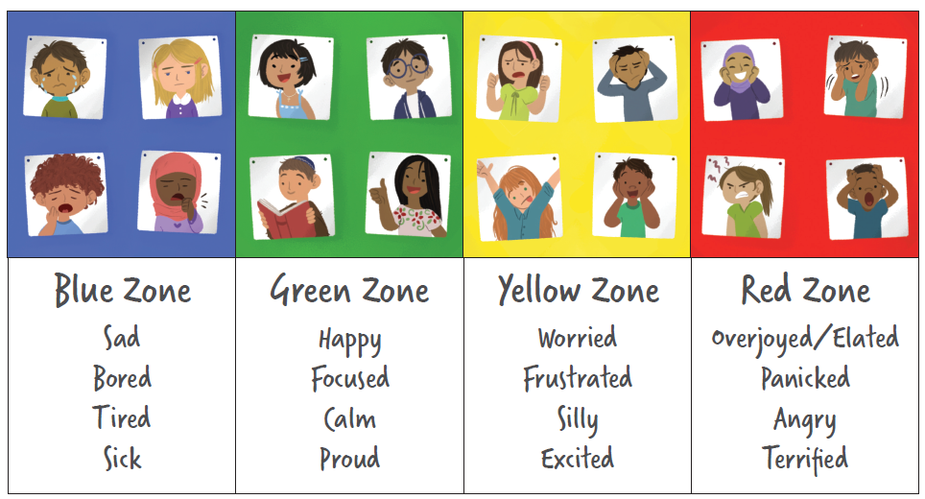
Zones of Regulation
These posters are in every classroom and will help you discuss and understand your feelings.

Slide 4
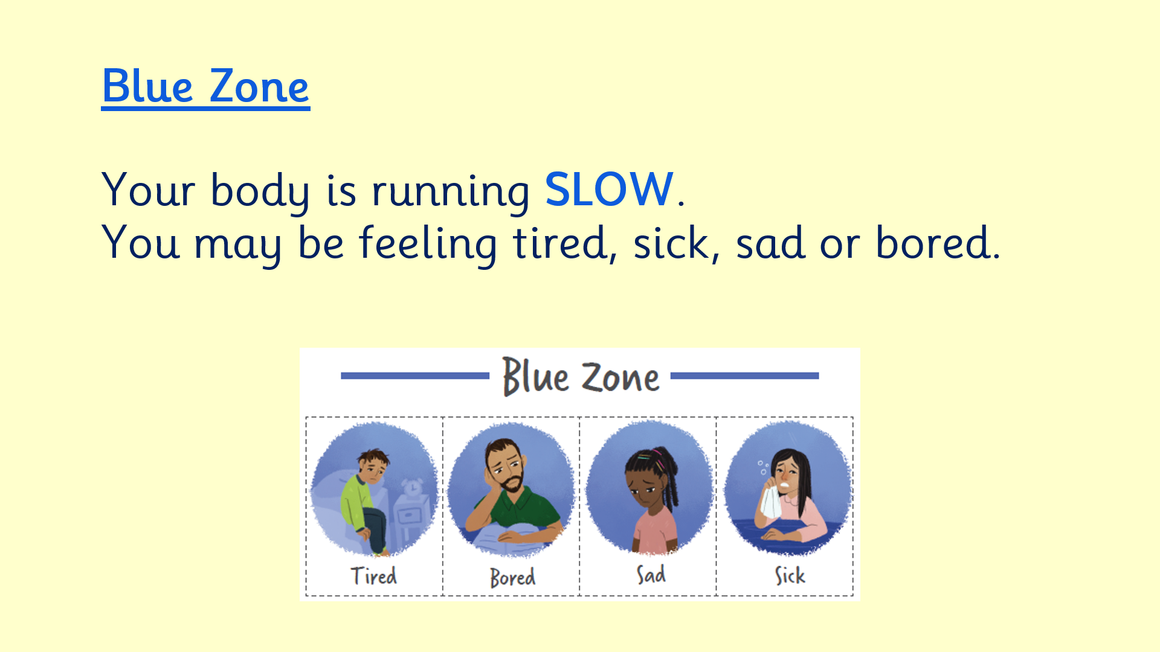
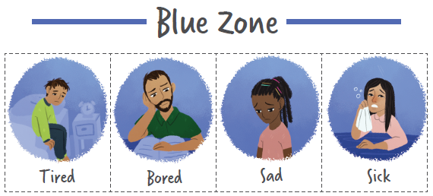
Blue Zone
Your body is running SLOW.
You may be feeling tired, sick, sad or bored.

Slide 5
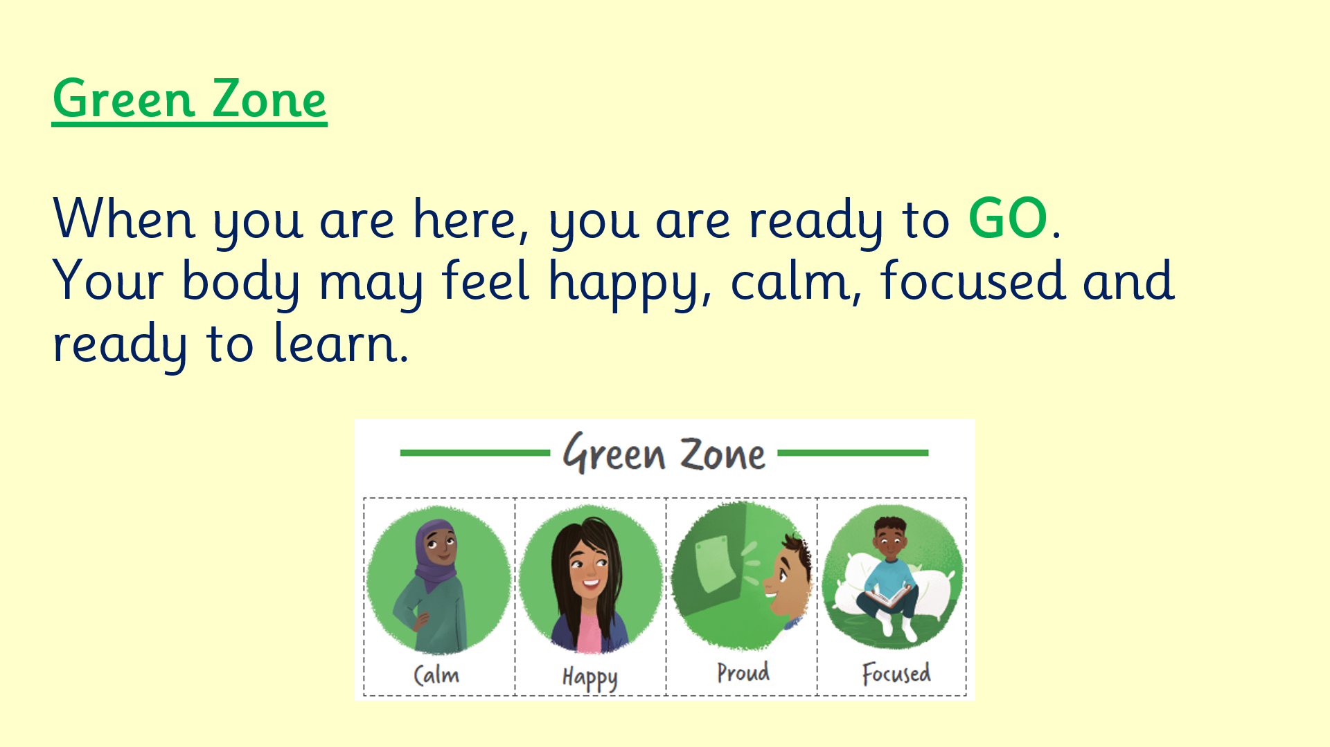
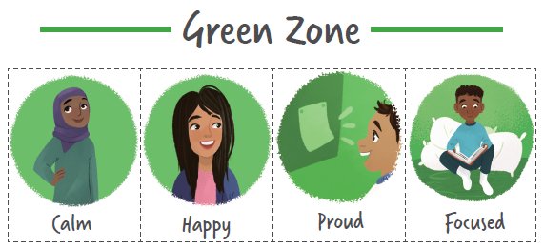
Green Zone
When you are here, you are ready to GO.
Your body may feel happy, calm, focused and ready to learn.

Slide 6
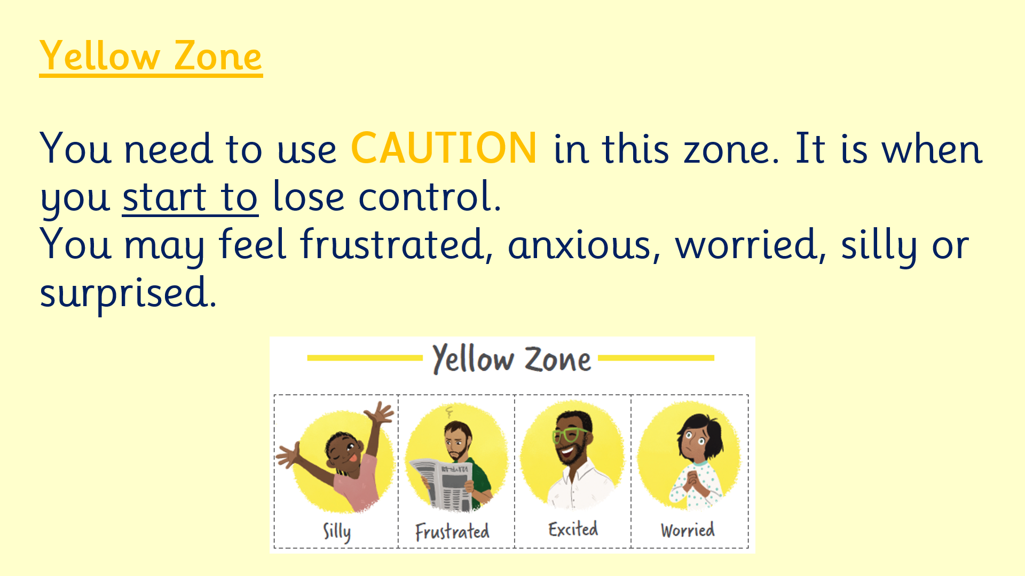
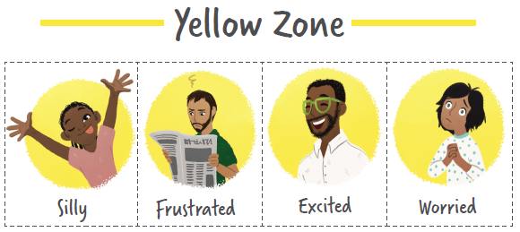
Yellow Zone
You need to use CAUTION in this zone. It is when you start to lose control.
You may feel frustrated, anxious, worried, silly or surprised.

Slide 7
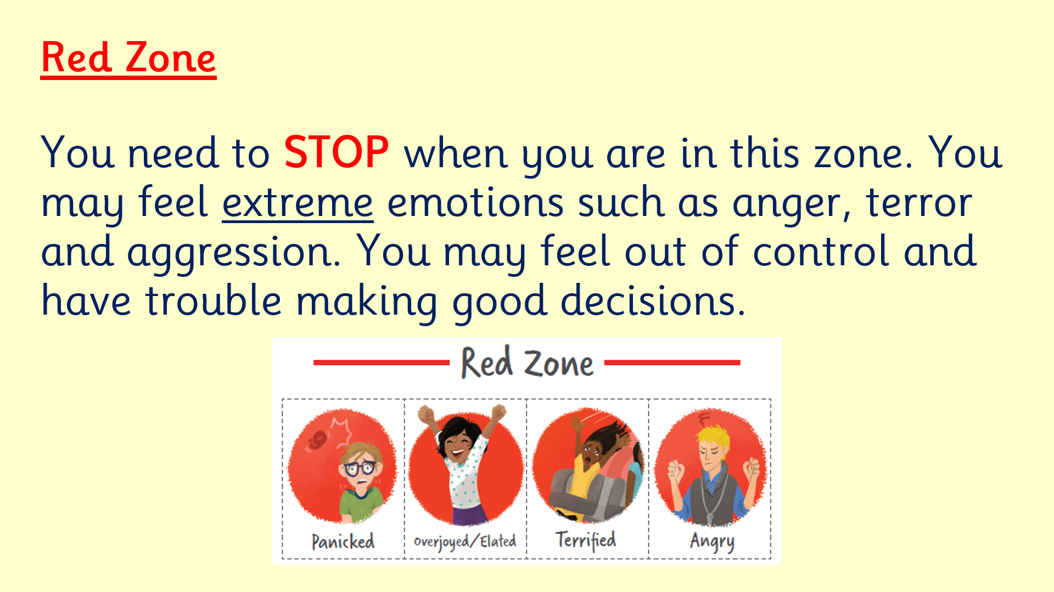
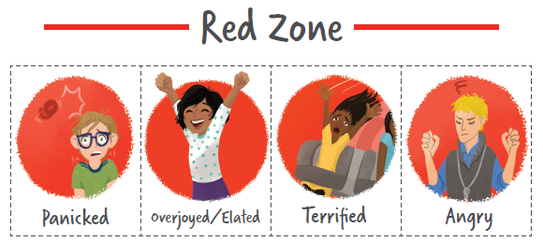
Red Zone
You need to STOP when you are in this zone. You may feel extreme emotions such as anger, terror and aggression. You may feel out of control and have trouble making good decisions.

Slide 8
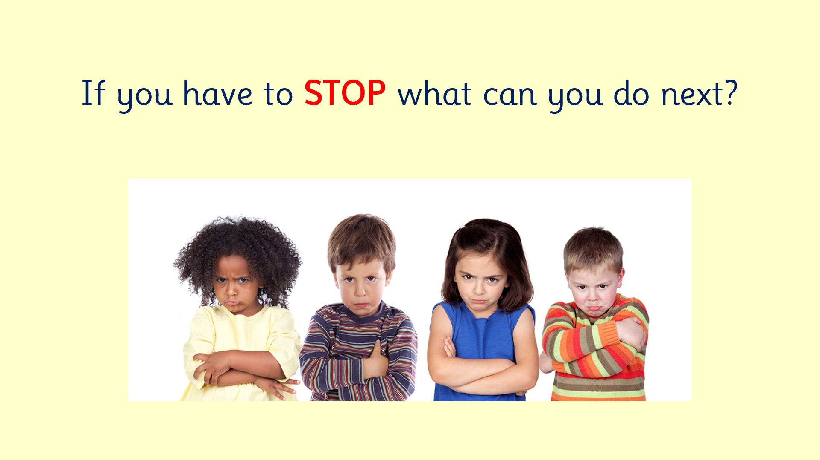

If you have to STOP what can you do next?

Slide 9
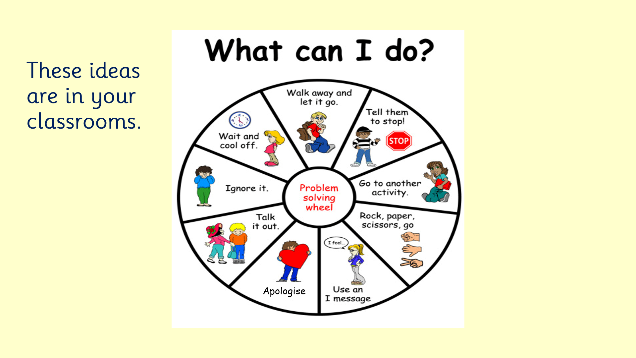
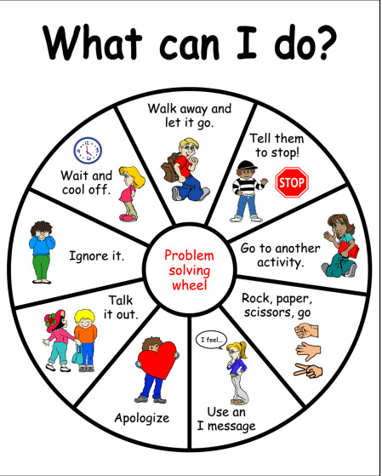
These ideas are in your classrooms.
Apologise

Slide 10
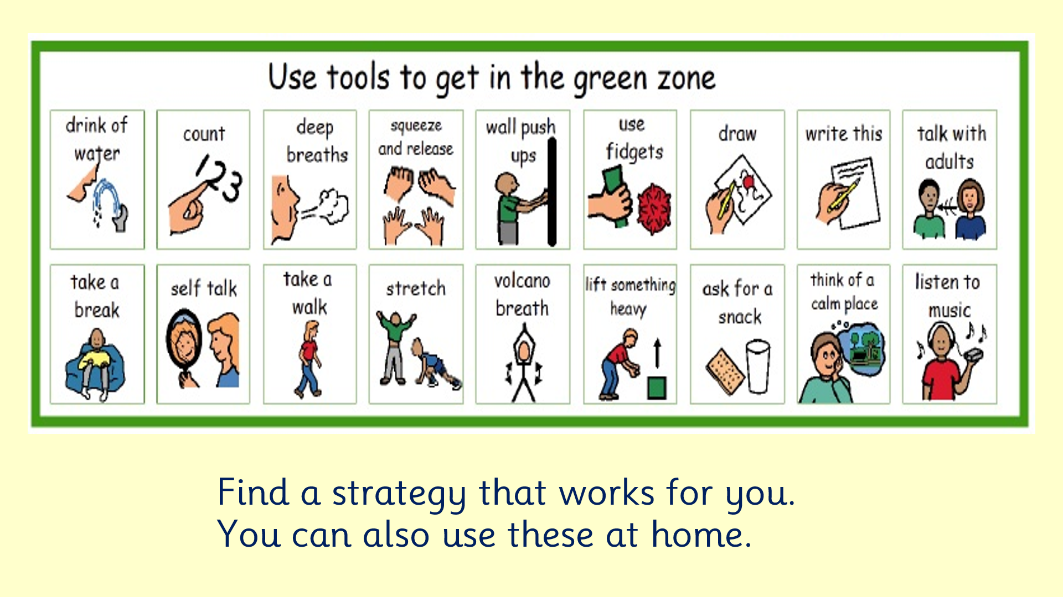
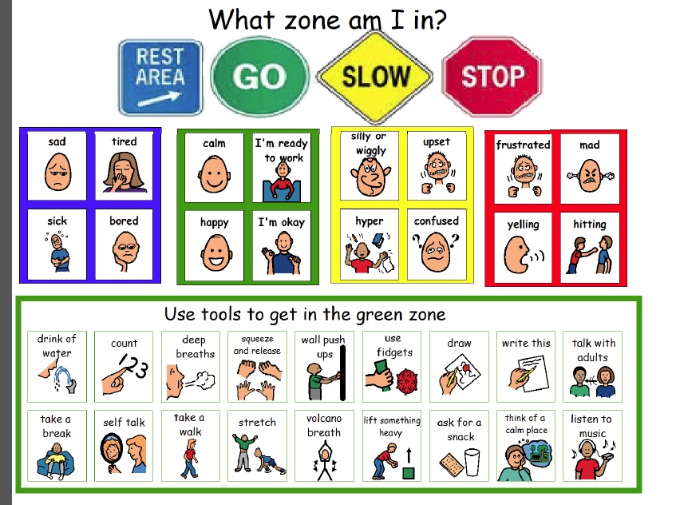
Find a strategy that works for you. You can also use these at home.

